Slide 1

Wi-vi Technology a close look on “Wireless Vision”…
By G RAVITEJA

Slide 2
CONTENT
1.what is Technology
2.Introduction
3.Working of Wi-vi Technology
4.Challenges faced & method used for evaluation
5.Results
6.Advantages
7.Limitations
8.Applications
9.Conclusion
10.Future Scope

Slide 3

What is Technology ?
All the different and usable technologies developed by a culture or people is called Technology.

Slide 4
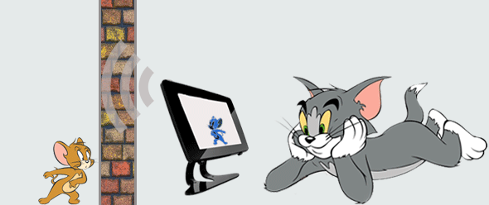
What is Wi-Vi ?
Wi-vi is one of the most modern technology which relies the Wi- Fi technology to make the concept of wireless vision possible.

Slide 5
From the Development….
The history of Wi-Fi lies in the campus of MIT (Massachusetts Institute of Technology).
Developed by professor Dina Katabi and her graduate student Fadel Adib.
Developed in science and Al laboratory of MIT by the faculty and student of electrical & computer science department in 2013.

Slide 6
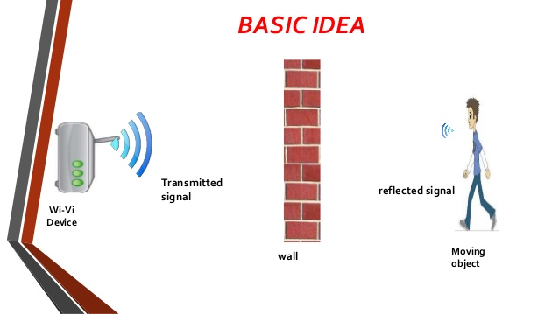
Method of approach
The main logic or idea is the tracking and manipulation of reflected Wi-Fi signals.
It can hence be called as an adaption of sonar or radar.

Slide 7
Working
Two antennas transmit identical signals where the second antenna signal is the inverse of the first.
This cause interference for imaging.
Wi-Vi relies on a simple 2.4 GHz Wi-Fi hardware radio.
Simply this can be decoded on handled devices.

Slide 8
During the motion of the target, the distance of it changes with respect to receiver.
It changes the time that reflected signal takes to get back to receiver.
Only those reflections that changes between the two signals such as those from the moving object arrive back at the receiver.

Slide 9
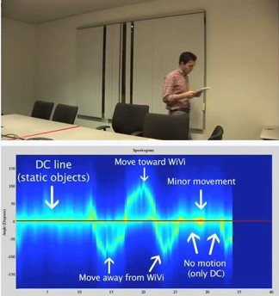

Slide 10
Challenges faced in designing :
Due to the obstructions and intermediate object it is essential to generate more sharper output rays.
The major challenges faced are:
Challenge #1: “Flash” effect
Challenge #2: Identifying & Tracking humans

Slide 11
#1: “Flash” effect
In this technology, the most challenging part is the reflections for the wall itself rather than reflections form the object.
Due to reflection off the wall, minute variations coming through the object are prevented from being tracked.
This behaviour is known as flash effect.
To cancel both wall reflections and direct signal from transmitting and receiving antenna, Wi-Vi uses interference nulling.
This increase the sensitivity of the reflections.
Multi Input Multi Output (MIMO) antennas are used to nullify the flash effect.

Slide 12
Nulling can be performed in the presence of objects moving behind the wall and front of the wall.
It involves following steps:
-Initial nulling
Initial output signals are nullified.
-Power nulling
MIMO radars and antennas boost the power of signal to increase the sharpness.
-Iterative nulling
Nulling is done continuously on final signals.

Slide 13
#2: Identifying & Tracking humans
By using the principle ISAR – Inverse Synthetic Aperture Radar.
It uses the movement of the target to emulate an antenna array.
Here, there is only 1 receiver antenna; Hence, at any point in time, we capture a single measurement, since the target is moving, consecutive measurements in time emulate an inverse antenna array.
By processing such consecutive measurements using standard antenna array beam steering, Wi-Vi can identify the spatial direction of human.

Slide 14
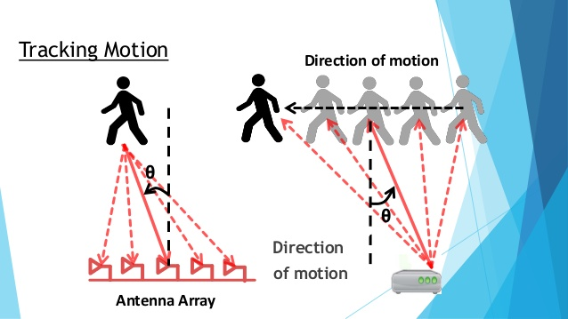

Slide 15
Results
Detect movements behind opaque structural obsructions
Wi-vi device pointed at a closed room with 6” hollow walls supported by steel frames can distinguish between 0, 1, 2, and 3 moving humans in the room. Computed over 80 trials with 8 human subjects, Wi-vi achieves an accuracy of 100%, 100%, 90%, and 85% respectively in each of these cases.
A single person sending gesture based messages, Wi-vi correctly decodes all messages performed at distance equal to or smaller than 5 meters.
The decoding accuracy decreases to 75% at distances of 8 meters, and the device stops detecting gestures beyond 9 meters.
It also removes clutter from all static reflectors, rather than just one wall. This includes other walls in the environments as well as furniture inside and outside the imaged room.

Slide 16
Advantages
Wi-Vi is relatively a low-power, low-cost, low-bandwidth, and accessible to average users.
Wi-Vi requires only few MHz of bandwidth and operates in the same range as Wi-Fi. It operates in ISM band
Wi-Vi employs signals whose wavelengths are 12.5cm
Extend human vision beyond the visible electromagnetic range, allowing us to detect objects in the dark or in smoke.

Slide 17
Limitations
Display has very low resolution.
Detection of human is only possible for walls below 8 inch thickness.
To achieve a narrow beam the human needs to move by about 4 wavelengths(=50 cm).
Short range of communication is possible.

Slide 18
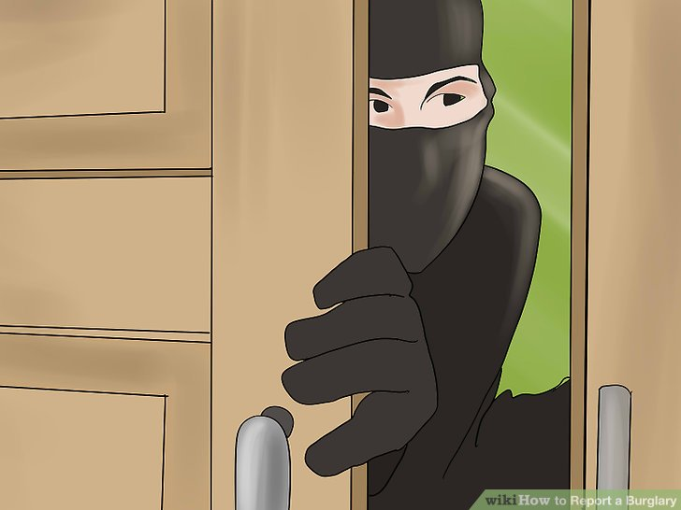
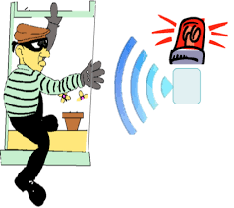
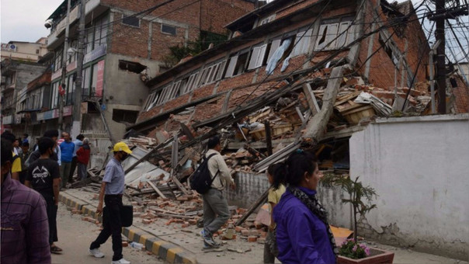

Applications
Personal security
Intruder detection

Slide 19
Conclusion
Wi-vi, a wireless technology that uses Wi-Fi signals to detect moving humans behind walls and in closed rooms. In contrast to previous systems, which are targeted for the military, Wi-Vi enables small cheap see-through-wall devices that operate in the ISM band, rendering them feasible to the general public, without carrying any transmitting device.

Slide 20
Future scope
Wi-Vi could be built into a Smartphone or a special handheld device.
Evolution of seeing humans through denser building material and with a longer range.
High quality images.

Slide 21
Thank you … . . ..

